Slide 1
Run 8650 Initial Efficiency Results
Tanvi Krishnan
Mentor: Gianluca Petrillo

Slide 2
Run 8650 Details
Run 8650 (July 2022) and 7232 (Nov 2021) are both minimum bias runs
PMT readout window is (-69 µs, 117 µs) – wider than the previous (-75µs, 75µs)
Run statistics (number of tracks) are as follows:
We do not use the reconstructed flashes for the trigger efficiency analysis
Trigger emulation window selection: (-15µs, 5µs) in the West cryostat and (-20µs, 0µs) in the East cryostat
 | East Cryostat Track Count | West Cryostat Track Count | Number of Events | Duration of Run
Run 7232 | 12568 | 16240 | 81.0k | 6.18 hours
Run 8650 | 16214 | 19834 | 74.9k | 21.4 hours

Slide 3
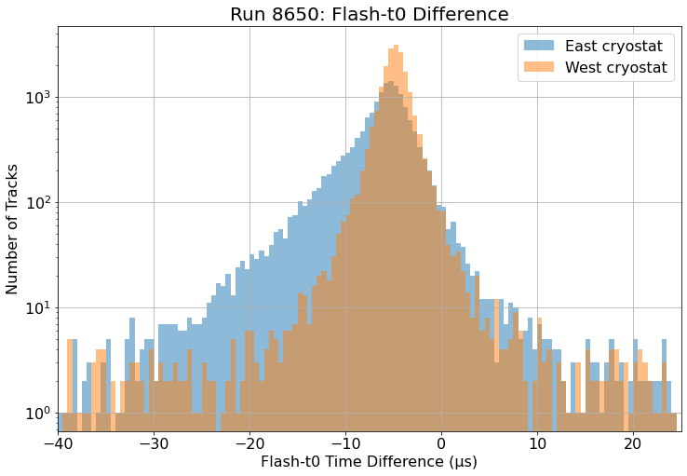
Trigger Emulation Windows
Selected the blue emulation window (-15µs, 5µs) for the East cryostat and the orange emulation window (-20µs, 0µs) for the West cryostat

Slide 4
Efficiency Plots

Slide 5
Efficiency as a function of Track Length
Run 7232
East Cryostat
West Cryostat

Slide 6
Efficiency as a function of Track Length
Run 8650
East Cryostat
West Cryostat

Slide 7
Efficiency as a function of Track Length
East Cryostat
West Cryostat

Slide 8
Efficiency as a function of Track Length
Only tracks with flashes within the trigger emulation window for each cryostat
East Cryostat
West Cryostat

